Slide 1
Proximal Methods and ADMM

Slide 2
Proximal methods:
A class of methods
for solving optimization Problems

Slide 3
I have passed SSLC
Give me 9th std optimization
problem

Slide 4
dL(x,y,z)/dx=2x-z=0
dL(x,y,z)/dy=2y-z=0
➔x=y=z/2➔x+y=z
dL(x,y,z)/dz=x+y-1=0
➔x=y=1/2
Solve x+y=1
Infinite Solution
(0,1)
Find point with minimal norm on x+y=1
Only one Solution
Min x² + y²
x+y=1
Lagrangian is
L(x,y,z)=(x² + y² )-z(x+y-1)
(1,0)

Slide 5
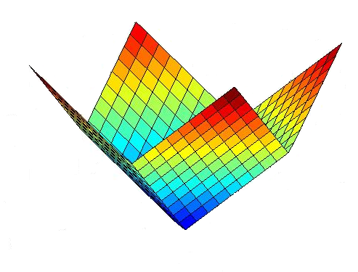
Non-smooth functions
Non Smooth Function - l1 norm

Slide 6
Non-smooth+Smooth

Slide 7
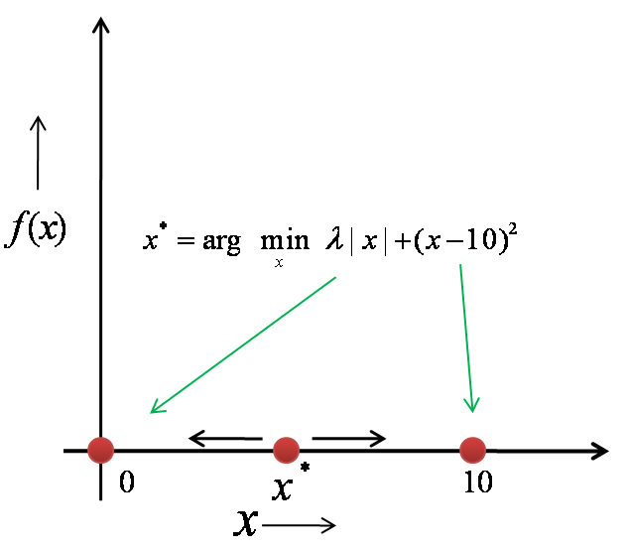
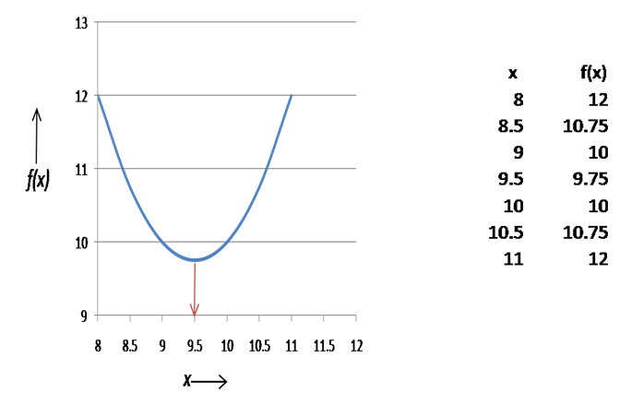
Non-smooth + Smooth=well behaved Finding optimal point
Solution point is always between 0 and location
of vertex of parabola which is c

Slide 8
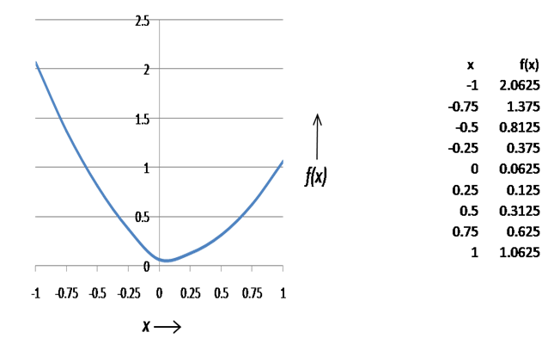
Sign inversion
Algorithm for 1D
if
Else
Shrink towards zero but do not cross

Slide 9
2D
other wise 0
other wise 0

Slide 10
Exercise

Slide 11
Another equivalent form
Algorithm

Slide 12
Proximal methods and Proximal Operators
Notation used in ADMM
Proximal operator of a function

Slide 13
ADMM-Alternating Direction Method of Multipliers

Slide 14
Why ADMM ?
ADMM is a simple and powerful iterative algorithm for convex optimization problems.
It is almost 80 times faster for multivariable problems than conventional methods.
A DMM put linear and quadratic programming in a single frame work.

Slide 15
ADMM
Form-1
z-surrogate variable to x
u-lagrangian multipliers
If f(x) and g(z) are differentiable
High dim parabola
High dim parabola

Slide 16
ADMM -Philosophy
Increase number of variables from one set to three set , solve one set at a time
Lagrangian Multiplier term
Augmented langrangian term

Slide 17
KKT Conditions are same

Slide 18
KKT Conditions are same

Slide 19
ADMM
Update of x in k+1 th iteration

Slide 20
Lagrangian function is:
So the update for x can be written as

Slide 21
Update of z in the k+1 th iteration.
We assume x and y vectors are known.
We rewrite Lagrangian as follows

Slide 22
Update of y in the k+1 th iteration.
So to move towards maximum , y is moved along gradient direction from the current position

Slide 23
We combine 2nd and 3rd term in the first two optimization into a single term

Slide 24
We verify it by expansion.
Consider first optimization

Slide 25
We verify it by expansion.
Consider second optimization term

Slide 26
Simplify
With

Slide 27
Let us be more wise after the event
Start with augmented Lagrangian function in the following form
instead of
If you are able to remember above, we can easily write first two optimization quite easily
Notes:
U = lambda*y or U = y/rho

Slide 28
ADMM-Form II
Convert into
Indicator function
Augmented Lagrangian function can be written as

Slide 30
Explanation for projection
Consider augmented Lagrangian
Omitting constant terms

Slide 31
Linear and Quadratic Programming
Reduce to
Indicator Function for

Slide 32
LP and QP
(2)
(3)
(1)

Slide 33
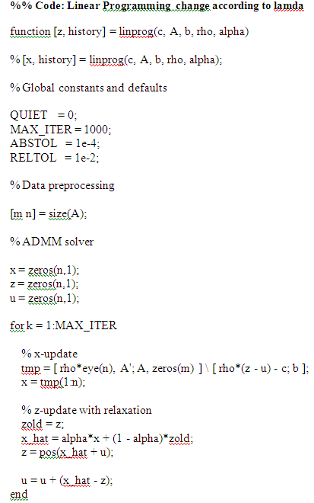
LP

Slide 34
Choose any three from
16 problems
given in the ADMM web site
by Boyd
https://web.stanford.edu/~boyd/papers/admm/

Slide 43
ADMM for two more
Optimization Problems
LP,QP,SVM,LASSO,BP,LAD

Slide 47
Remember

Slide 49
Basis Pursuit
A good proxy for finding the sparsest solution to an underdetermined system of equations Ax = b is to solve

Slide 50
Projection on to Az=b

Slide 51
C:\Users\admin\Desktop\RL_David
C:\Users\admin\Desktop\RL Deep Assignments 2018-19\RL full PPTS
Compressed sensing
Single pixel camera
Multispectral camera
Sampling theorem

